Slide 1
Nutrition analysis of Starbucks Beverages
Iram Habiba Tarique
Navya Hannumanthan Rao
Prashansa Nande
Siddharth Gehlot
Niva Thekdi

Slide 2
Dataset
Dataset contains information about the nutrient values of various beverages served at Starbucks.
It contains 18 variables and 241 observations.
The dataset has few character and categorical variables and the remaining are numerical variables.

Slide 3
Preparing Dataset
Rows containing missing data were omitted.
Observations having string values were replaced with numerical values.
Further, all the character variables in the dataset were converted to numerical.

Slide 4
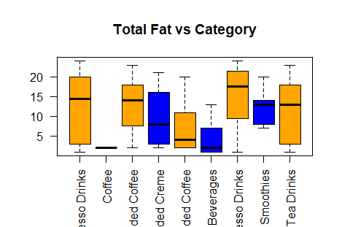
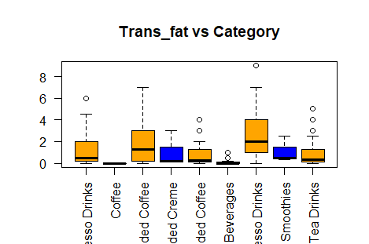
Bi-Variate Analysis

Slide 5
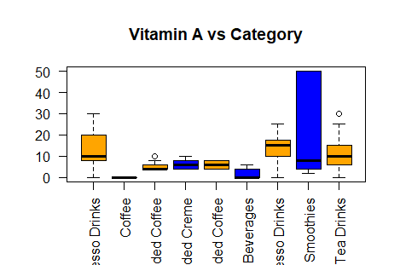
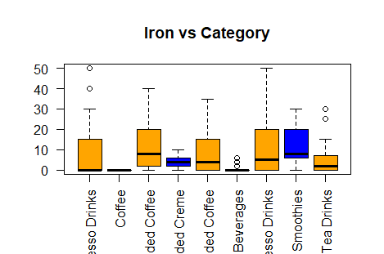
Bi-Variate Analysis

Slide 6
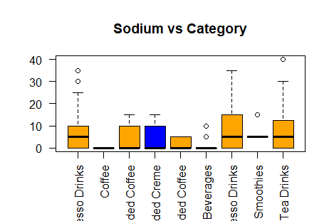
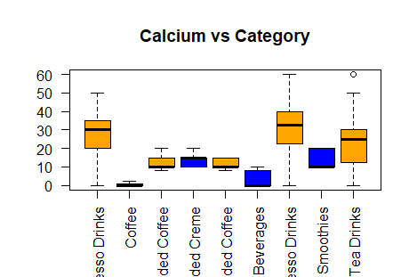
Bi-Variate Analysis

Slide 7
Cluster Analysis
Cluster Analysis is a multivariate method
It is the task of grouping a set of observations or data points such that the objects in the same cluster(group) are more similar to each other than those in the other clusters
This method identifies and classifies objects on the basis of similarity of the characteristics they posses
Clusters can be represented graphically in the form of Scatter diagram

Slide 8
Cluster Analysis
Clustering based on Vitamin-A, Calcium and Iron variables
Final Partition
Cluster Centroids
 | Number of observations | Within cluster sum of squares | Average distance from centroid | Maximum distance from centroid
Cluster1 | 87 | 113.674 | 1.010 | 2.860
Cluster2 | 93 | 32.140 | 0.545 | 0.931
Cluster3 | 61 | 199.462 | 1.584 | 4.593
Variable | Cluster1 | Cluster2 | Cluster3 | Grand centroid
Vitamin.A....DV..1 | -0.1108 | -0.7505 | 1.3022 | 0.0000
Calcium....DV..1 | 0.0529 | -0.8925 | 1.2854 | 0.0000
Iron....DV..1 | 0.3936 | -0.5259 | 0.2403 | 0.0000

Slide 9
Cluster Analysis
Distances Between Cluster Centroids
 | Cluster1 | Cluster2 | Cluster3
Cluster1 | 0.0000 | 1.4658 | 1.8813
Cluster2 | 1.4658 | 0.0000 | 3.0893
Cluster3 | 1.8813 | 3.0893 | 0.0000

Slide 10
Cluster Analysis
Clustering based on Carbohydrate, Protein and Fibre variables
Final Partition
Cluster Centroids
 | Number of observations | Within cluster sum of squares | Average distance from centroid | Maximum distance from centroid
Cluster1 | 89 | 47.891 | 0.681 | 1.312
Cluster2 | 126 | 195.853 | 1.183 | 2.970
Cluster3 | 26 | 67.246 | 1.499 | 2.790
Variable | Cluster1 | Cluster2 | Cluster3 | Grand centroid
Total.Carbohydrates..g. | -0.9943 | 0.6475 | 0.2657 | 0.0000
Dietary.Fibre..g. | -0.3881 | -0.1806 | 2.2036 | 0.0000
Protein..g. | -0.6877 | 0.1273 | 1.7372 | 0.0000

Slide 11
Cluster Analysis
Distances Between Cluster Centroids
 | Cluster1 | Cluster2 | Cluster3
Cluster1 | 0.0000 | 1.8446 | 3.7662
Cluster2 | 1.8446 | 0.0000 | 2.9021
Cluster3 | 3.7662 | 2.9021 | 0.0000

Slide 12
Cluster Analysis
Clustering based on Calories, Total Fat and Trans Fat variables
Final Partition
Cluster Centroids
 | Number of observations | Within cluster sum of squares | Average distance from centroid | Maximum distance from centroid
Cluster1 | 105 | 82.556 | 0.767 | 2.185
Cluster2 | 94 | 85.313 | 0.880 | 2.236
Cluster3 | 42 | 70.770 | 1.150 | 3.533
Variable | Cluster1 | Cluster2 | Cluster3 | Grand centroid
Calories | -0.5467 | 0.0399 | 1.2776 | 0.0000
Total.Fat..g. | -1.0133 | 0.6678 | 1.0385 | 0.0000
Trans.Fat..g. | -0.7020 | -0.0154 | 1.7894 | 0.0000

Slide 13
Cluster Analysis
Distances Between Cluster Centroids
 | Cluster1 | Cluster2 | Cluster3
Cluster1 | 0.0000 | 1.9083 | 3.7074
Cluster2 | 1.9083 | 0.0000 | 2.2196
Cluster3 | 3.7074 | 2.2196 | 0.0000

